Slide 1
.Net Maui Navigation With Shell Step 2

Slide 2
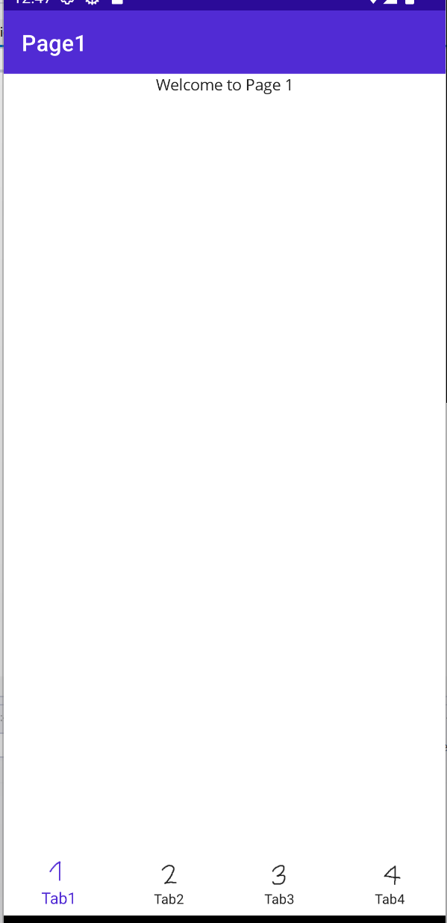
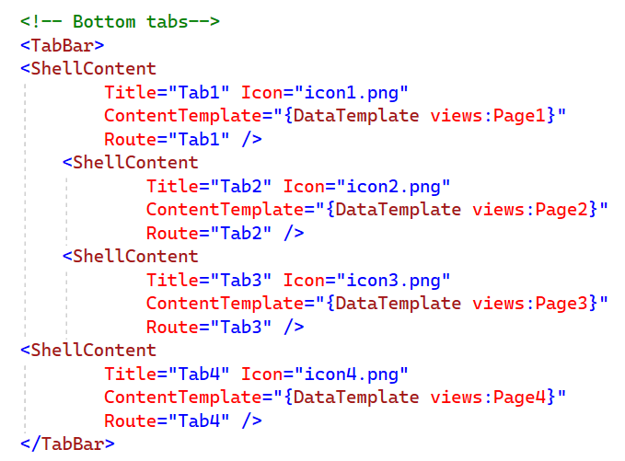
Bottom Tab Bar

Slide 3
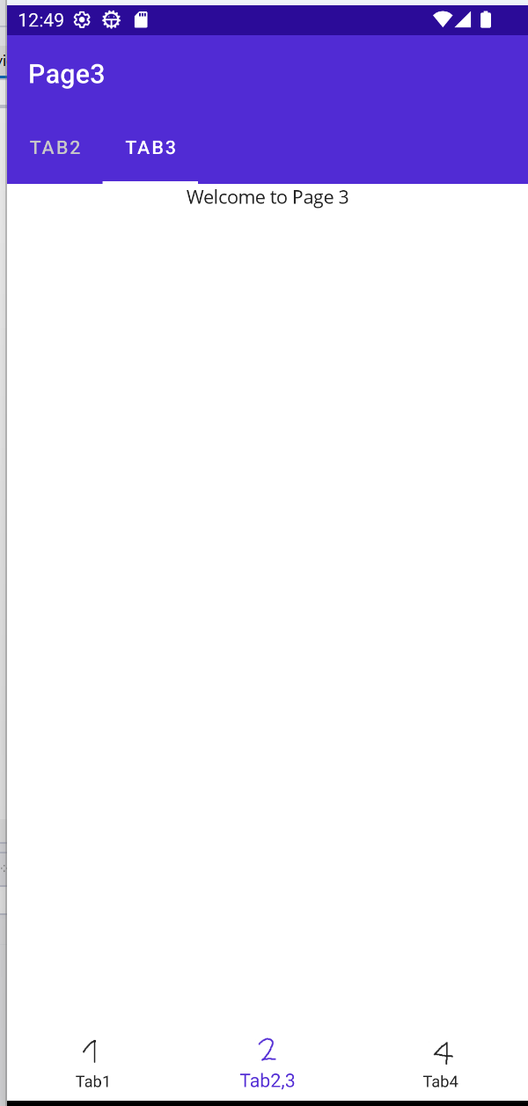
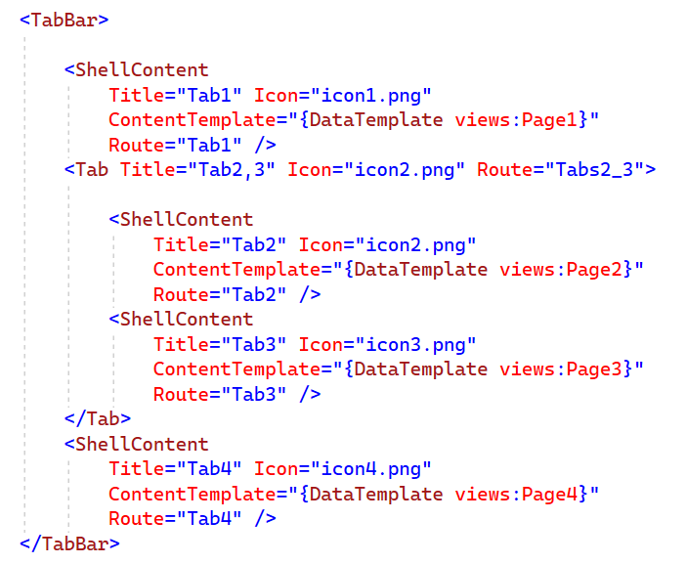
Bottom & Upper Tab Bar

Slide 4
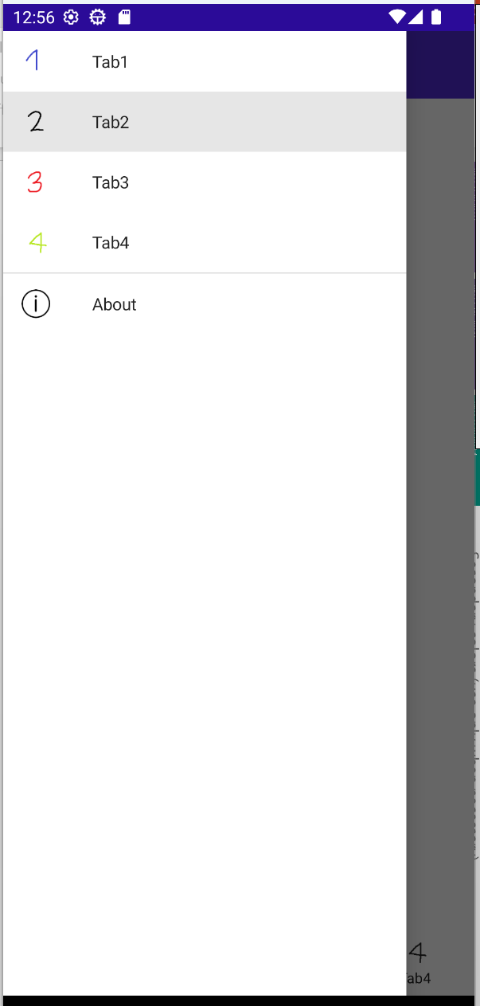
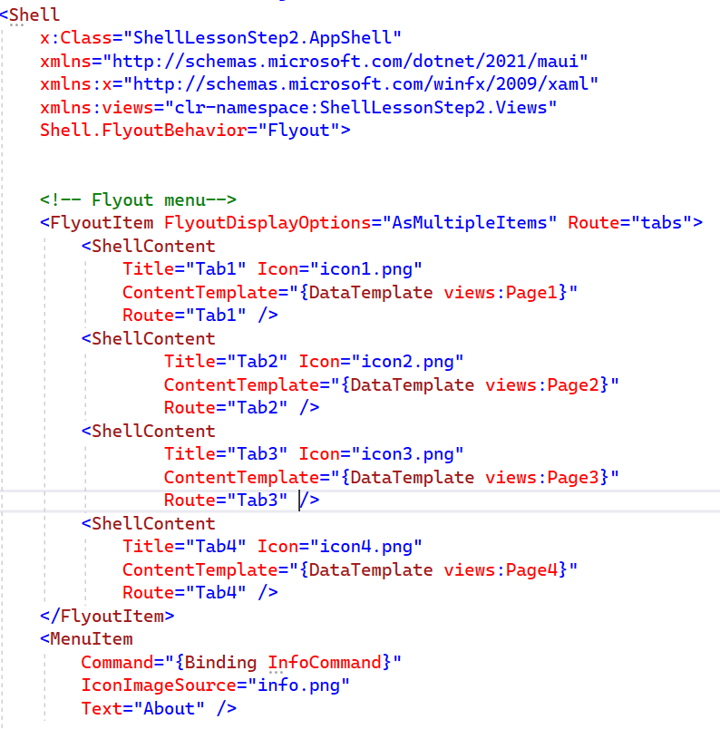

Flyout Item with menu

Slide 5
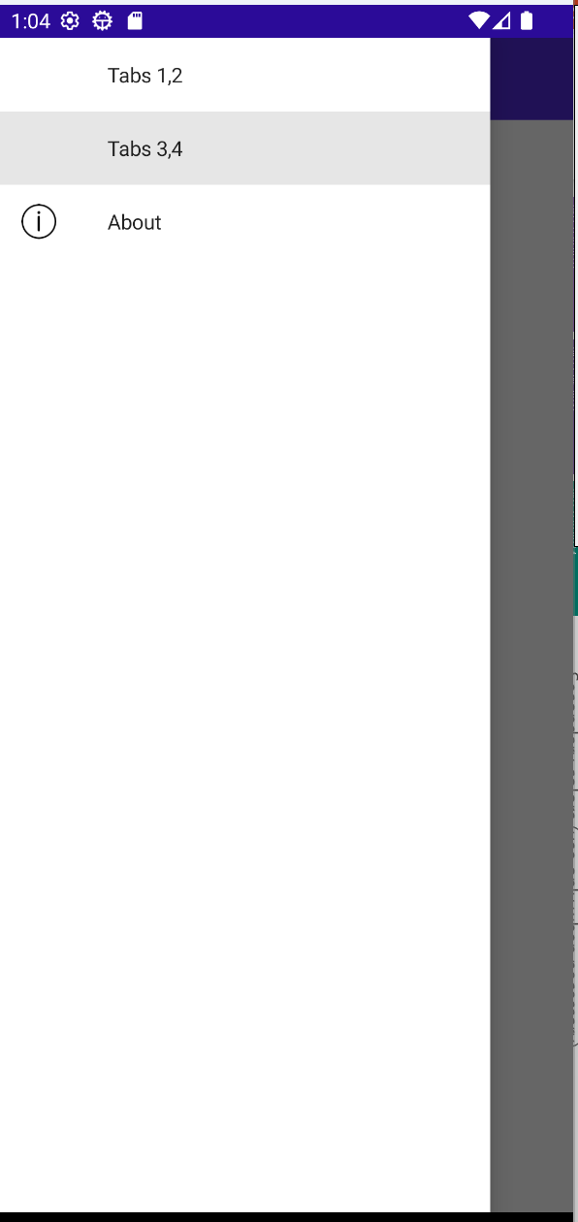
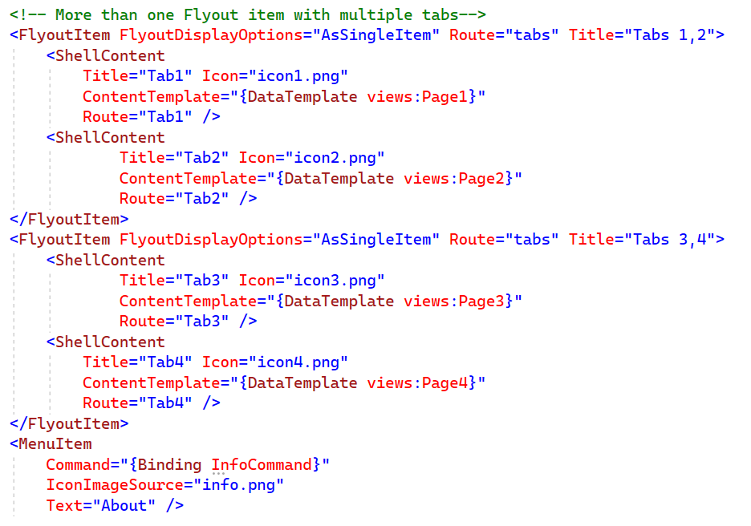



Few Flyout Items With Tabs

Slide 6
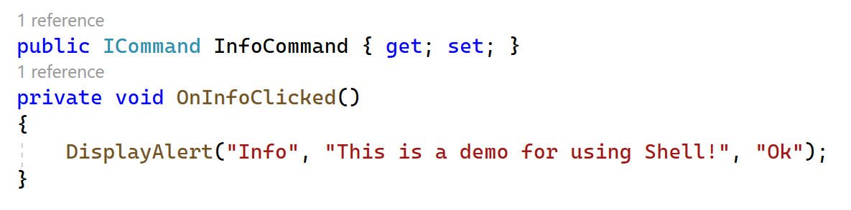
Opening Alert Dialog

Slide 7
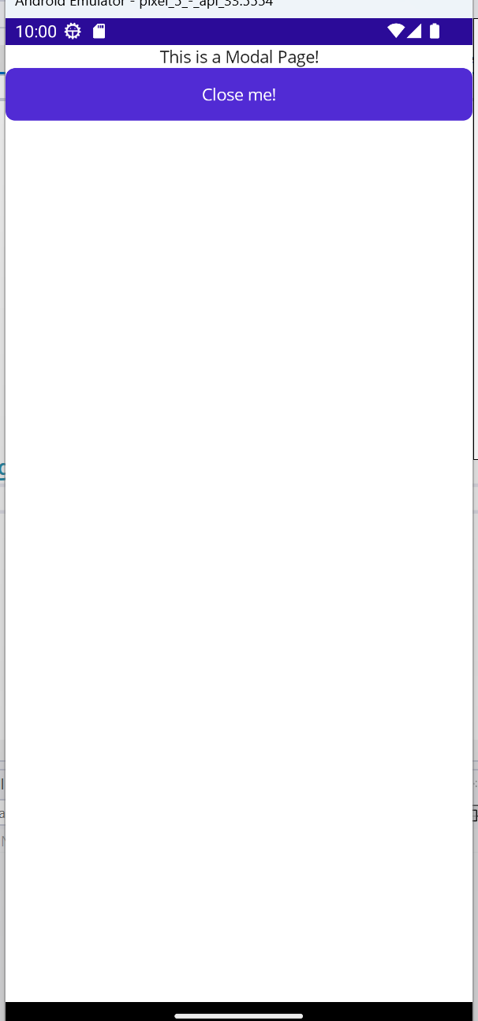
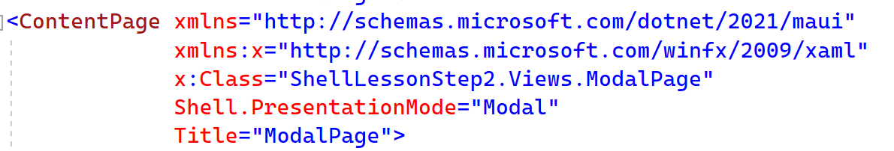
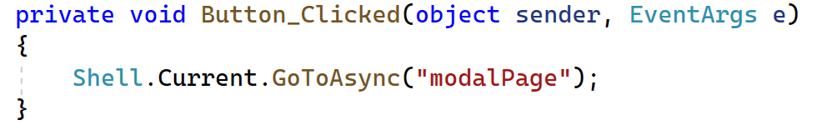
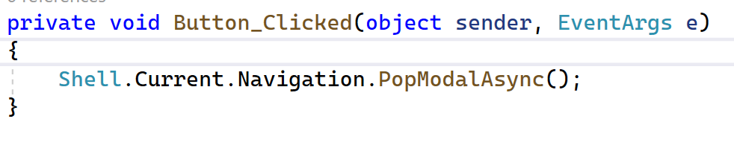
Modal pages

Slide 8
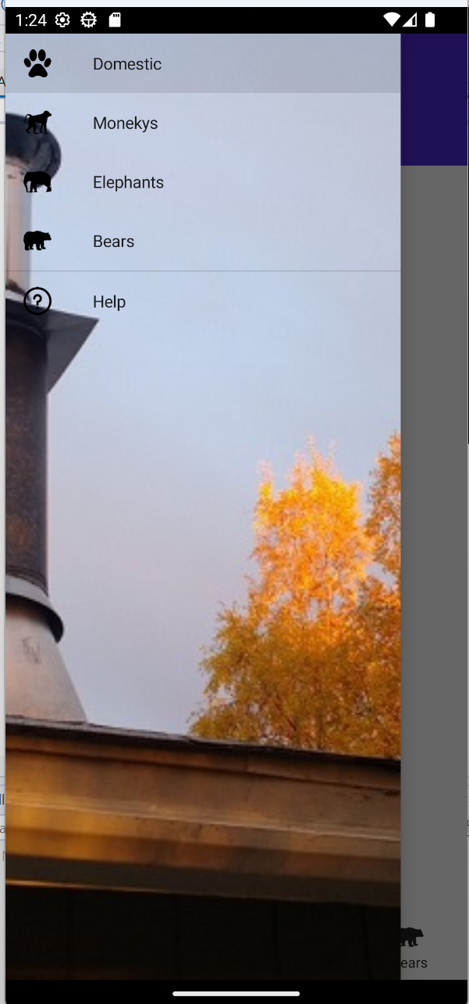
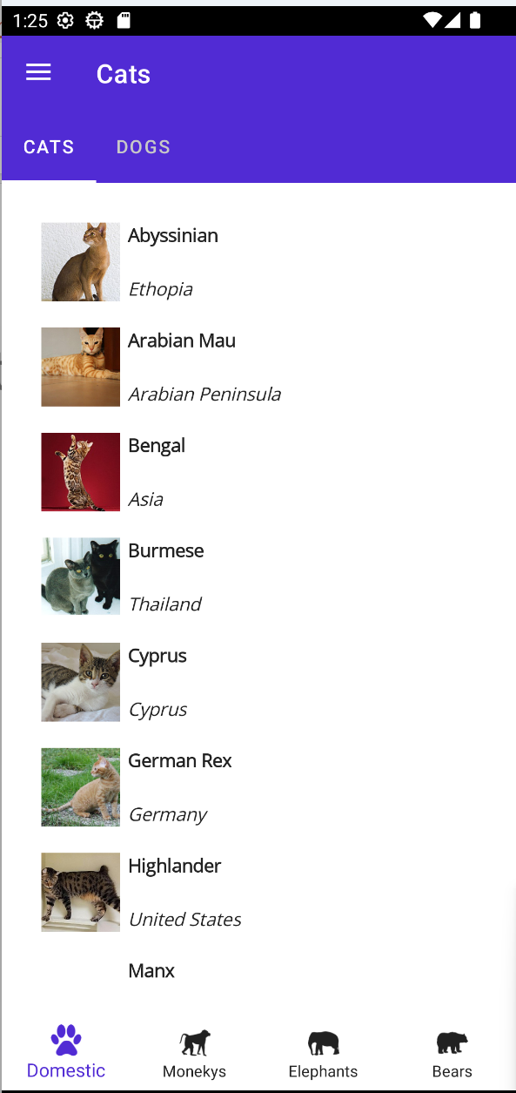
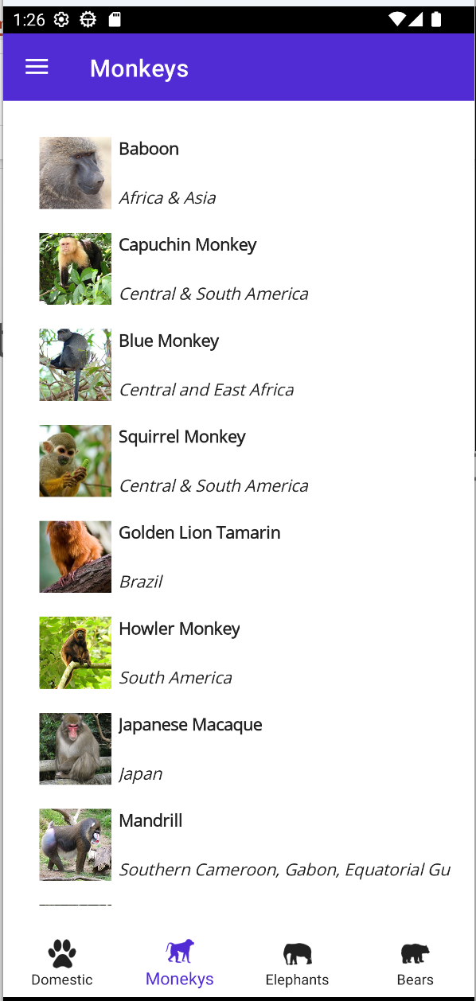
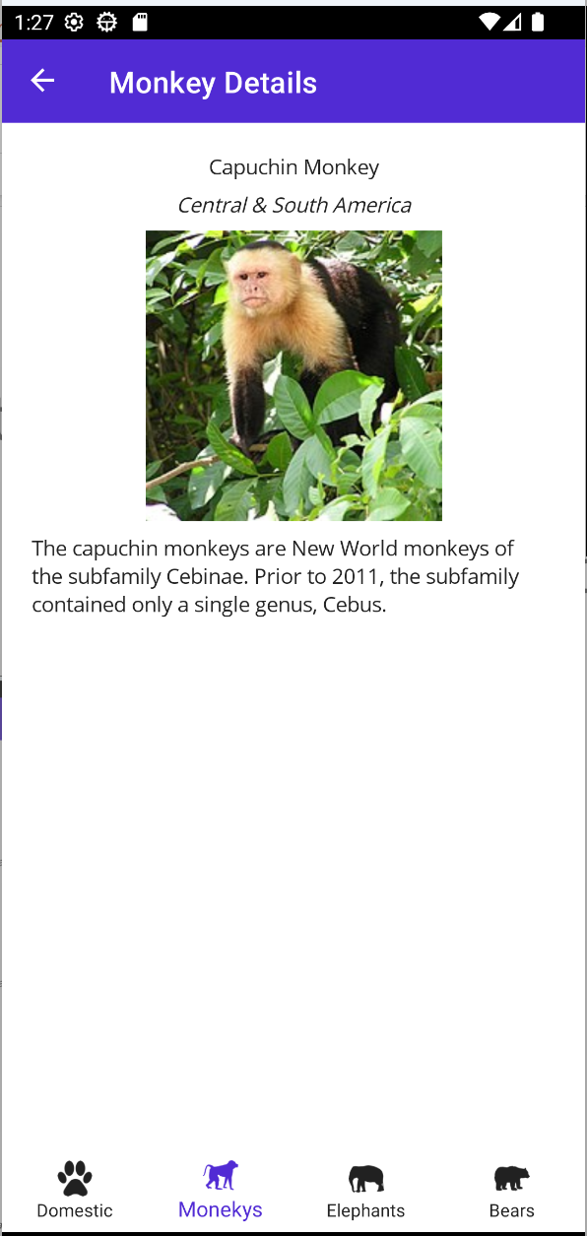
Exercise
Modify this project to create the following application.
Note the Animal model class and Animal Service class that provides all data needed for the app.
All required images and icons are on the resources folder

Slide 9
Exercise 2 – Preparing the Trivia App Structure
Create an App structure that will be used for the final exercise – The trivia app!
First page to be loaded will be a Login / Registration page. Once this step is over, the user will be directed to the app.
On the Flyout menu the following items:
Start Game
Profile
Questions
Pending Questions
My Questions

